Slide 1
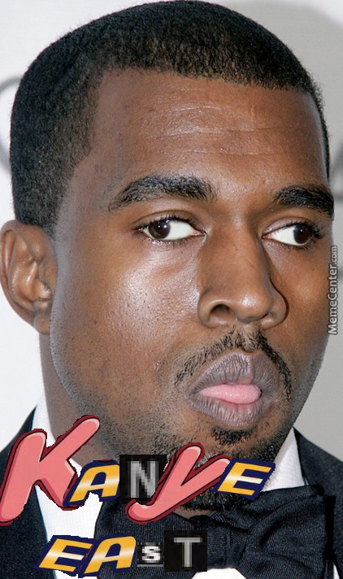
PILLARS
Every time catch ten items the rate at which they drop increases by .0000005.
Must avoid Drakes CLB album covers or be reset to 0.
Catch the ¥ to earn 2 points.
Beat the max score of 1,000,000 and win a free pair of yeezys.

Slide 2
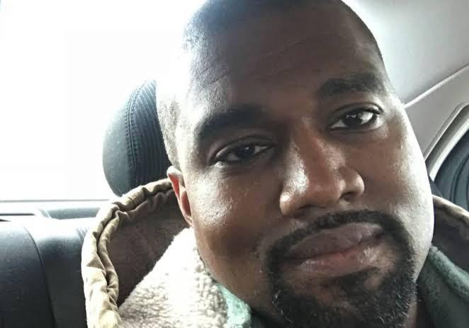
FEATURES
Real Kanye West including face and Voice Acting.
Features the hit song Homies in Paris.
Unlock new characters by earning in game currency from playing.
Unlockable characters include,
Travis Scott and Kim Kardashain.

